Slide 1
LEAD SCORE CASE STUDY
Prepared By :-
Tanusree Halder
Jai Batra
Thomas Kuruvila

Slide 2
Problem Statement
X Education sells online courses to industry professionals.
X Education gets a lot of leads, its lead conversion rate is very poor. For example, if, say, they acquire 100 leads in a day, only about 30 of them are converted.
To make this process more efficient, the company wishes to identify the most potential leads, also known as ‘Hot Leads’.
If they successfully identify this set of leads, the lead conversion rate should go up as the sales team will now be focusing more on communicating with the potential leads rather than making calls to everyone.
Business Objective:
X education wants to know most promising leads.
For that they want to build a Model which identifies the hot leads.
Deployment of the model for the future use.

Slide 3
Solution Methodology
Data Cleaning and Data Manipulation
Check and handle duplicate data
Check and handle NA values and missing values
Drop columns with a large amount of missing values that are not useful for analysis
Imputation of values if necessary
Check and handle outliers in data
Exploratory Data Analysis (EDA)
Univariate data analysis: value count, distribution of variables, etc.
Bivariate data analysis: correlation coefficients and patterns between variables, etc.
Feature Scaling & creation of Dummy Variables and data encoding
Classification technique: Logistic Regression for model building and prediction
Model validation process
Presentation of the model
Conclusions and recommendations

Slide 4
Data Manipulation
Total number of rows: 37
Total number of columns: 9240
Dropped single value features:
"Magazine"
"Receive More Updates About Our Courses"
"Update me on Supply Chain Content"
"Get updates on DM Content"
"I agree to pay the amount through cheque"
Removed "Prospect ID" and "Lead Number" as they are unnecessary for analysis
Checked value counts for some object type variables
Identified certain features with insufficient variance

Slide 5
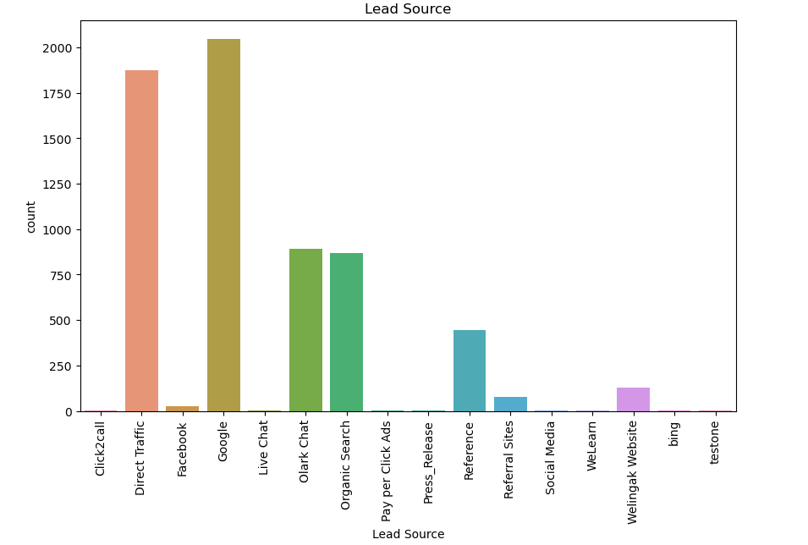
EDA

Slide 6
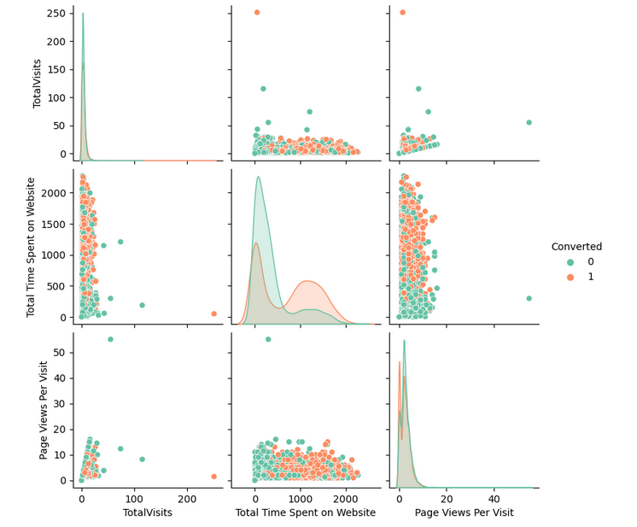

Slide 7
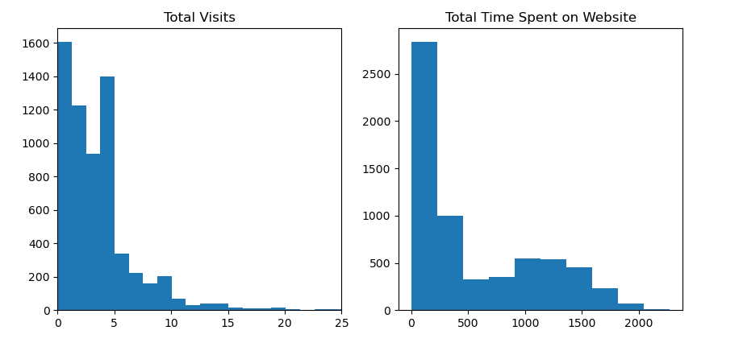

Slide 8
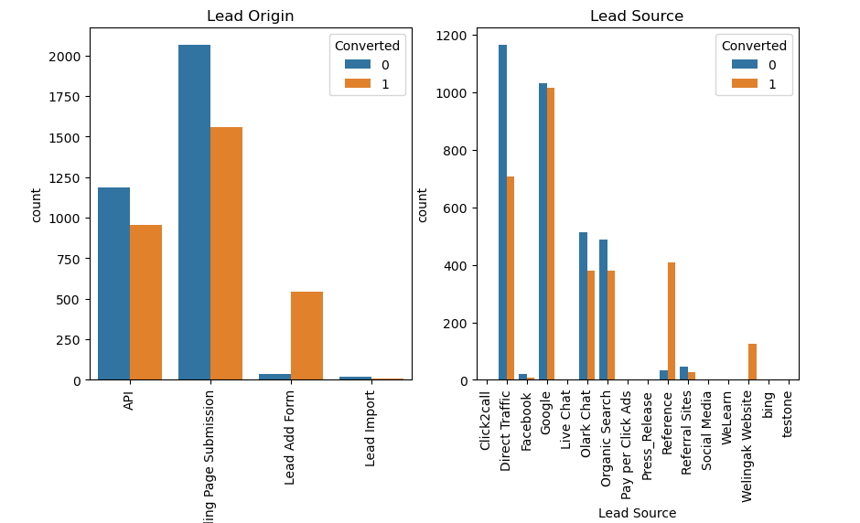

Slide 9
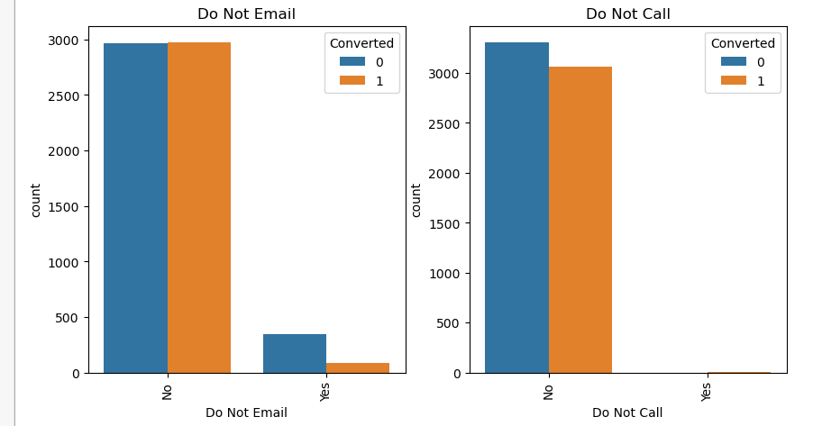

Slide 10
Data Conversion
Numerical variables have been normalized to ensure consistency in the analysis process.
Dummy variables have been created for object type variables to facilitate statistical modeling.
The dataset for analysis consists of a total of 8792 rows.
A total of 43 columns will be considered for the analysis.
These steps have been taken to ensure accuracy and efficiency in the analysis of the data.

Slide 11
Model Building
Regression Data Splitting
• Perform 70:30 train-test split.
• Use RFE for feature selection.
• Run RFE with 15 variables as output.
• Build model by removing variables with p-value > 0.05 and vif > 5.
• Predict test data set with 81% accuracy.

Slide 12
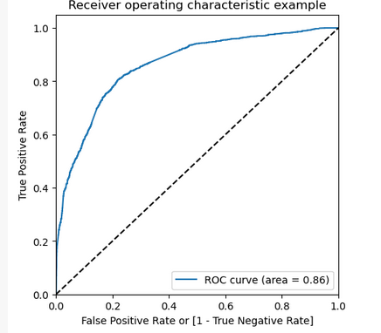
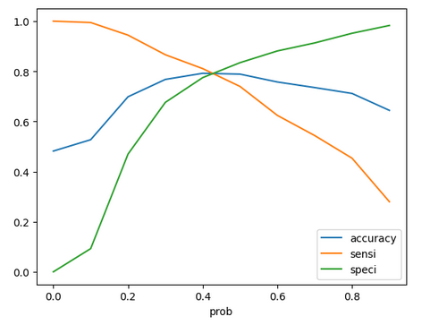
ROC Curve
Optimal Cut Off Point Finding
• Balanced sensitivity and specificity.
• Graph shows optimal cut off at 0.35.

Slide 13
Conclusion
Potential Buyers' Factors in Website Visits • Total time spent on website. • Total number of visits. • Lead source: Google, direct traffic, organic search. • Last activity: SMS, Olark chat conversation. • Lead origin: Lead add format. • Current occupation: Working professional. • X Education can thrive by influencing potential buyers to purchase courses.

Slide 14
THANK YOU

